Slide 1
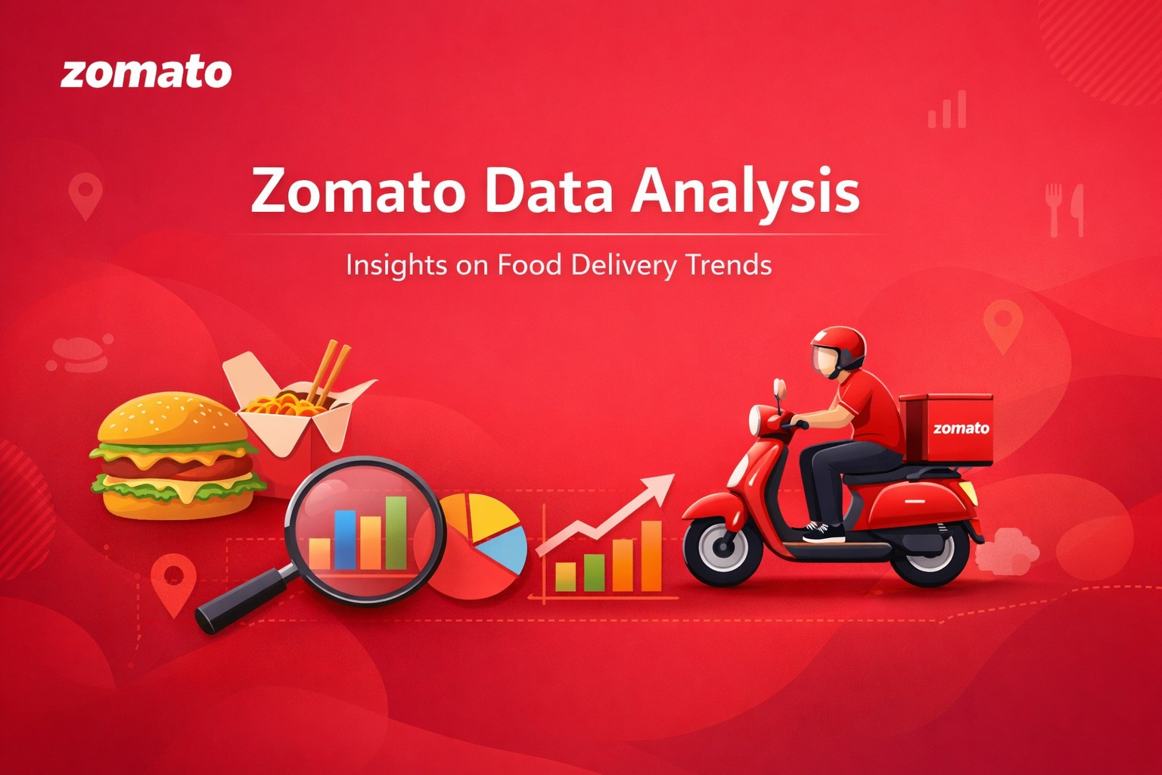

Slide 2
ZOMATO RESTAURANT DATA ANALYSIS
Excel | Power BI | SQL | Tableau
PRESENTED BY
Emlin Freeda P

Slide 3
Introduction
    Zomato is about analyzing restaurant data from Zomato to understand customer preferences and restaurant performance.
    Using this data, we can study details like restaurant ratings, locations, price range, online delivery, and table booking facilities.
    The main aim of this project is to find useful insights such as which restaurants have high ratings, which locations have more restaurants, and what type of services customers prefer.
    This analysis helps in understanding restaurant trends and supports better business decisions.

Slide 4
Data Cleaning & Preprocessing
    Challenges:
      Data contained null values, special characters in the field, currency was not distributed as per the countries.
    Steps Taken:
      Removed null values
      Standardized currency & location data
      Categorized price ranges
      Removed Special Characters in the field

Slide 5
Overview
    Dataset Overview:
      Number of restaurants: 9551
      Number of Countries : 15
      Number of Cities : 141
      Number of Cuisines : 1826
      Average Rating of all the restaurant : 2.89

Slide 6
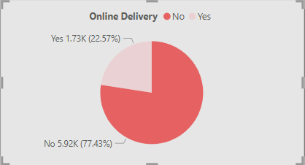
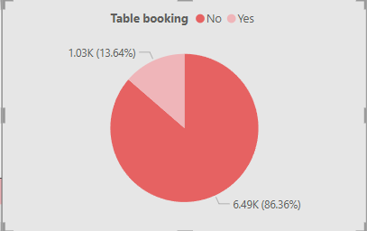
Observations
    Out of 9551 restaurants
      1.73K(22.57%) restaurants provides Online Delivery whereas 5.92k(77.43%) don’t have the online delivery system
    Out of 9551 restaurants
      1.03K(13.64%) restaurants provides table booking whereas 6.49k(86.36%) don’t have the table booking facility

Slide 7
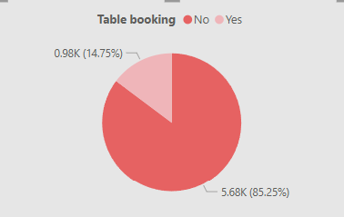
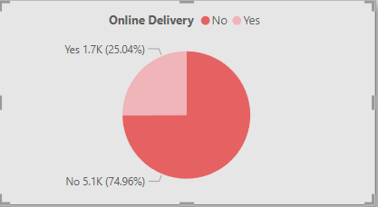
Analysis Form India
    Out of 8652 restaurants
      1.7K(25.04%) restaurants provides Online Delivery whereas 5.1k(74.96%) don’t have the online delivery system
    Out of 8652 restaurants
      0.98K(14.75%) restaurants provides table booking whereas 5.68k(85.25%) don’t have the table booking facility

Slide 8
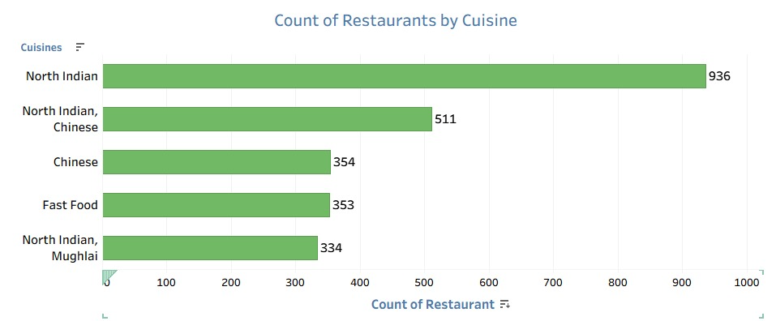
TOP 5 Count of Restaurants by Cuisine
  North Indian cuisine has the highest number of restaurants, around 930
  North Indian + Chinese is the second highest, around 510
  Chinese cuisine has around 360 restaurants
  Fast Food also has around 350 restaurants
  North Indian + Mughlai has around 330 restaurants.
  This means that North Indian cuisine is the most popular cuisine type in the dataset.

Slide 9
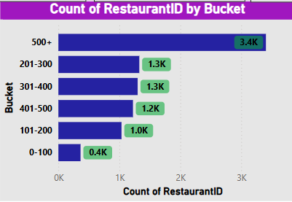
Count of Restaurant by Bucket
Average cost for two
Restaurants with Average cost for 2 between 0-100 bucket are 0.4k
Highest i.e 500+ average cost there are 3.4k restaurants.
Most restaurants fall into the 500+ category, suggesting market concentration at the higher end.
The middle categories (201-500) have a balanced distribution
This analysis suggests that a significant portion of restaurants have a high volume of Price, possibly due to chain restaurants or high operational scale

Slide 10
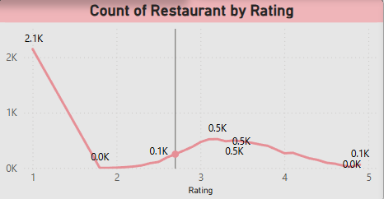
Highest count at Rating 1 (2.1K restaurants)
A significant number of restaurants received the lowest rating.
This could indicate dissatisfaction, poor service, or bad food quality for a large segment.
Sharp drop to nearly 0 at Rating 2
There is almost no representation at a rating of 2.
This suggests that restaurants either receive very low or moderate-to-good ratings, skipping the middle ground.
Gradual rise in Ratings 3 to 4 (around 0.5K each)
Ratings 3 and 4 have a similar number of restaurants (~500 each).
This indicates that a moderate number of restaurants are rated average to slightly above average.
Slight decline toward Rating 5
Only about 0.1K (100 restaurants) received a perfect 5-star rating.
This suggests that very few restaurants achieve the highest rating, possibly due to high customer expectations.

Slide 11
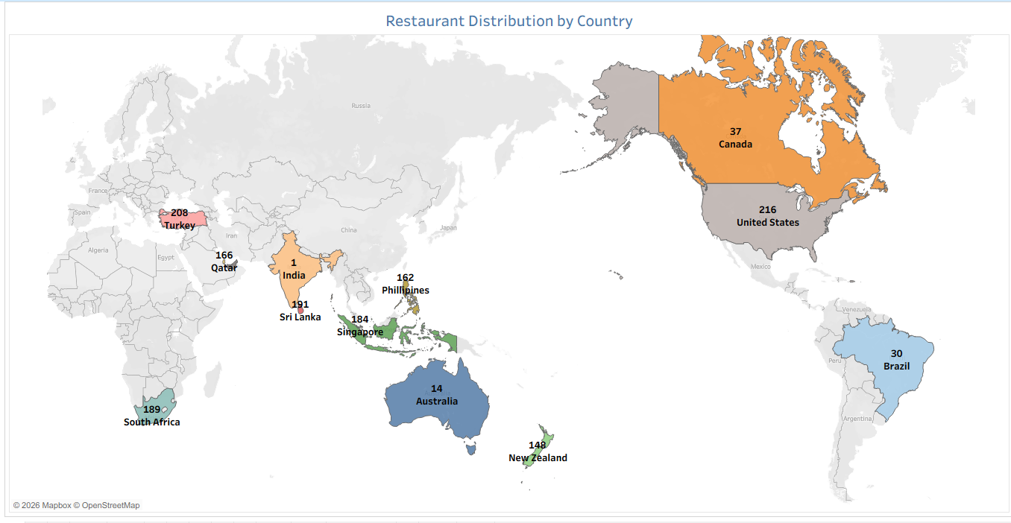
Restaurant Distribution by Country

Slide 12
KPI’S
      1. 🚚 Online Delivery Rate
      2. 📅 Table Booking Rate
      3. 🍜 Popular Cuisine KPI
      4. 💰 Average Cost KPI
      5. ⭐ Average Rating KPI
      6. 📉 Low Rating KPI
      7. 🌍 Location KPI

Slide 13
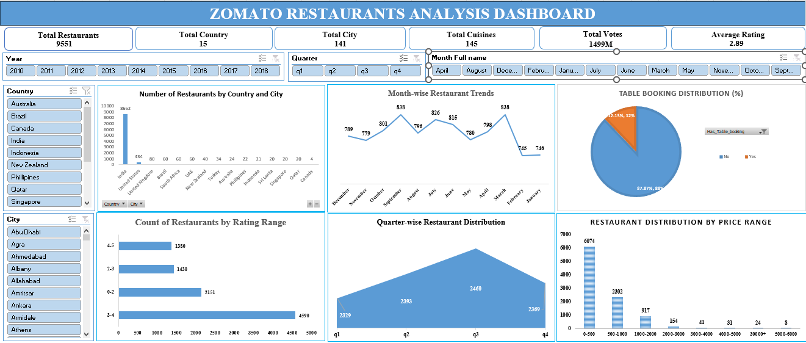

Slide 14
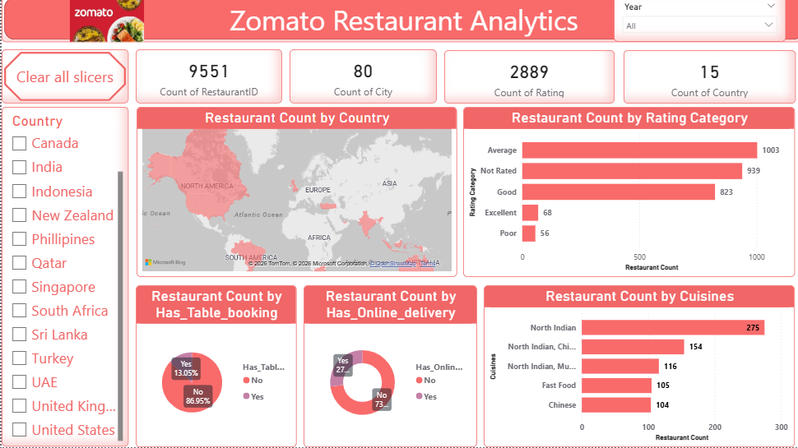

Slide 15
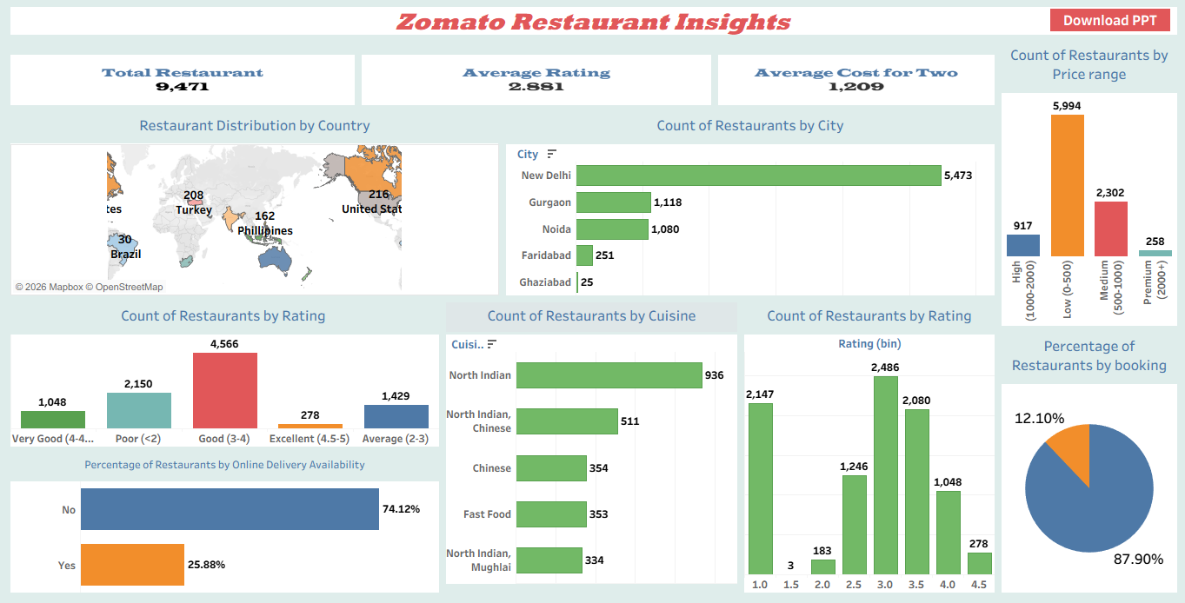

Slide 16
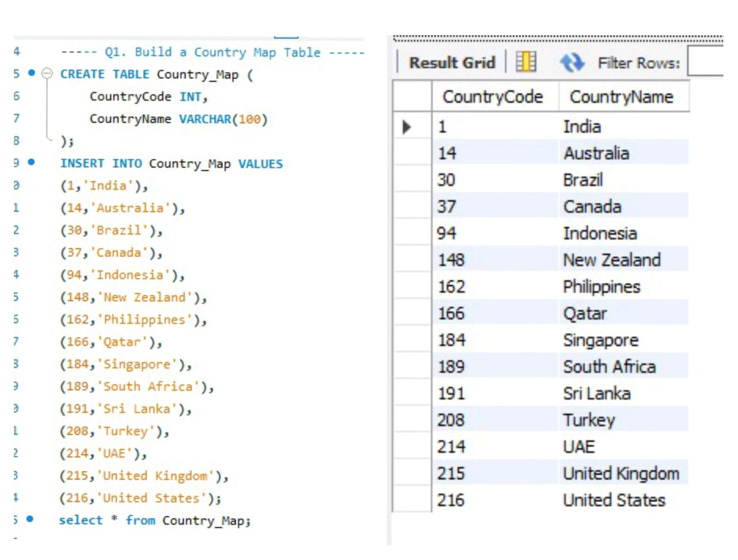
SQL Queries
A Country Map table is created with CountryCode and CountryName
Different countries are inserted with their unique codes
Each country is linked to a specific numeric ID
The table stores mapping between country code and country name
Final output displays all countries with their corresponding codes

Slide 17
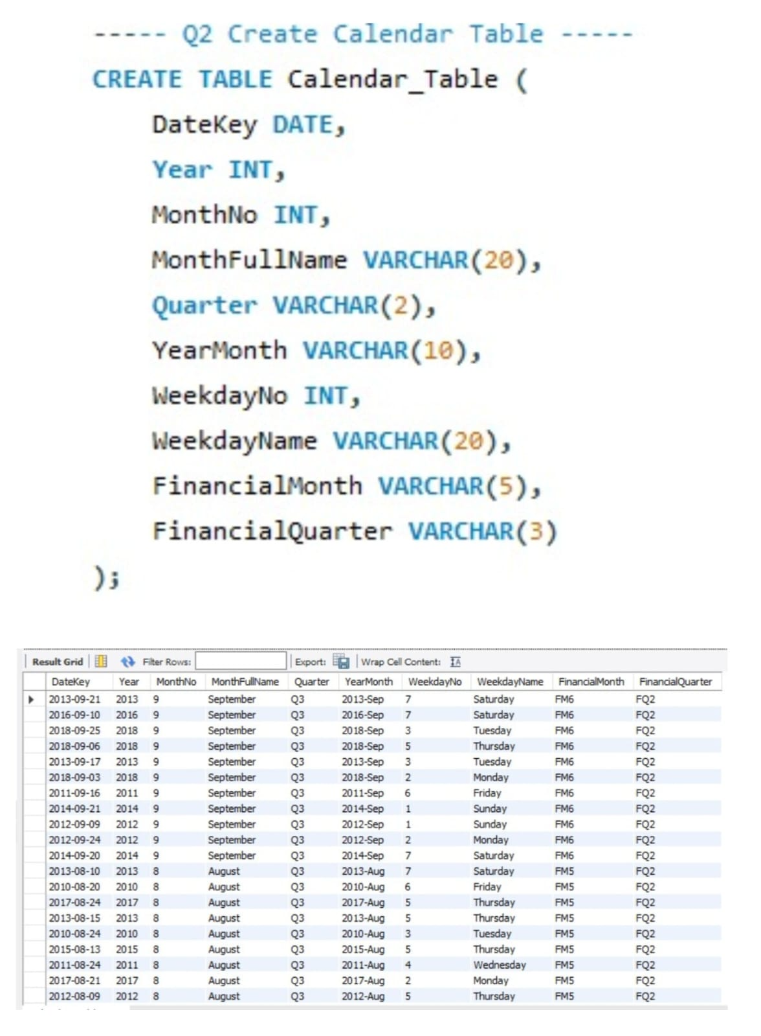
This table stores detailed date information like year, month, quarter, and weekday
It helps to analyze restaurant data based on time, like monthly and yearly trends
It also includes financial month and quarter, which helps in business-related analysis

Slide 18
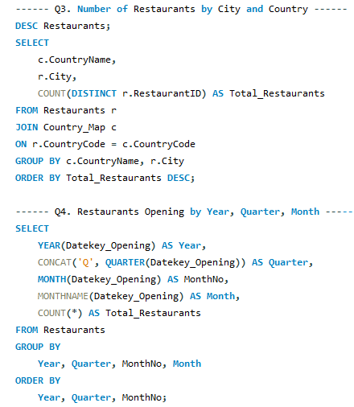
Combines city and country data
Counts restaurants and shows highest first
Gets year, quarter, and month from date
Counts openings and shows in order

Slide 19
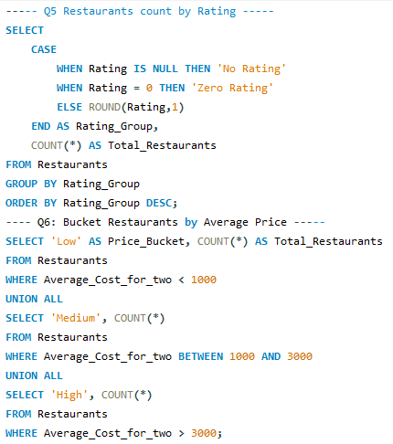
Groups ratings into categories like No Rating, Zero Rating, and others
Counts how many restaurants fall into each rating group
Divides restaurants into Low, Medium, and High price ranges based on cost
Counts how many restaurants are in each price category

Slide 20
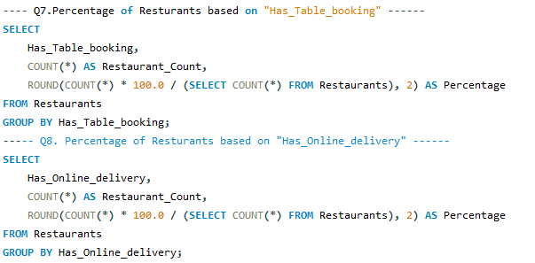
Groups restaurants by whether they have table booking or not
Counts them and calculates percentage out of total restaurants
Groups restaurants by whether they offer online delivery or not
Counts them and calculates percentage out of total restaurants

Slide 21
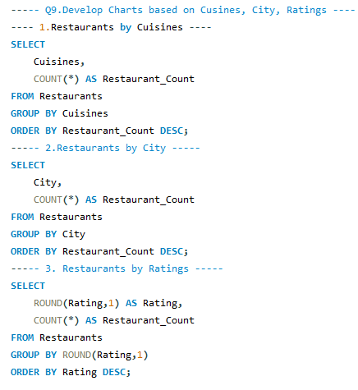
Counts how many restaurants are there for each cuisine, city, and rating
Groups the data separately by cuisine, city, and rating values
Sorts results from highest to lowest to easily create charts

Slide 22
Restaurant Performance & Profitability
    🔹 Identify Underperforming Restaurants: Compare ratings, reviews, and sales data to detect struggling locations.
    🔹 Cost & Profit Analysis: Track expenses, food costs, and delivery charges to optimize pricing strategies.
    🔹 Most Profitable Cuisines & Dishes: Identify high-margin cuisines and promote them accordingly.
    Business Growth Strategy
    🔹 Franchise & Expansion Strategy: Identify high-potential cities/countries for launching new branches.
    🔹 Strategic Marketing Plan: Use historical trends to optimize advertising budgets and promotions.
    🔹 Delivery & Logistics Optimization: Improve delivery efficiency by analyzing delivery times and costs.

Slide 23
CONCLUSION
      The Zomato restaurant analysis helps us understand how restaurants perform based on factors like location, ratings, cost, and services like online delivery and table booking.
      From the analysis, we can see that restaurants with higher ratings and good services attract more customers. Areas with more restaurants also show higher competition.
      Online delivery has become an important feature, as many customers prefer ordering food from home.
      Overall, this analysis shows that customer preferences, service quality, and pricing strongly impact a restaurant’s success. Businesses can use this data to improve their services and make better decisions.

Slide 24


